Slide 1

PROBLEM STATEMENT
Current e-commerce platforms struggle to deliver an immersive and personalized online shopping experience, resulting in a disconnect between virtual representation and real-world expectations.This leads:
- Ineffective User Engagement
- Lack of Tangibility
- Increased Product Returns
- Need for Technological Innovation

Slide 2
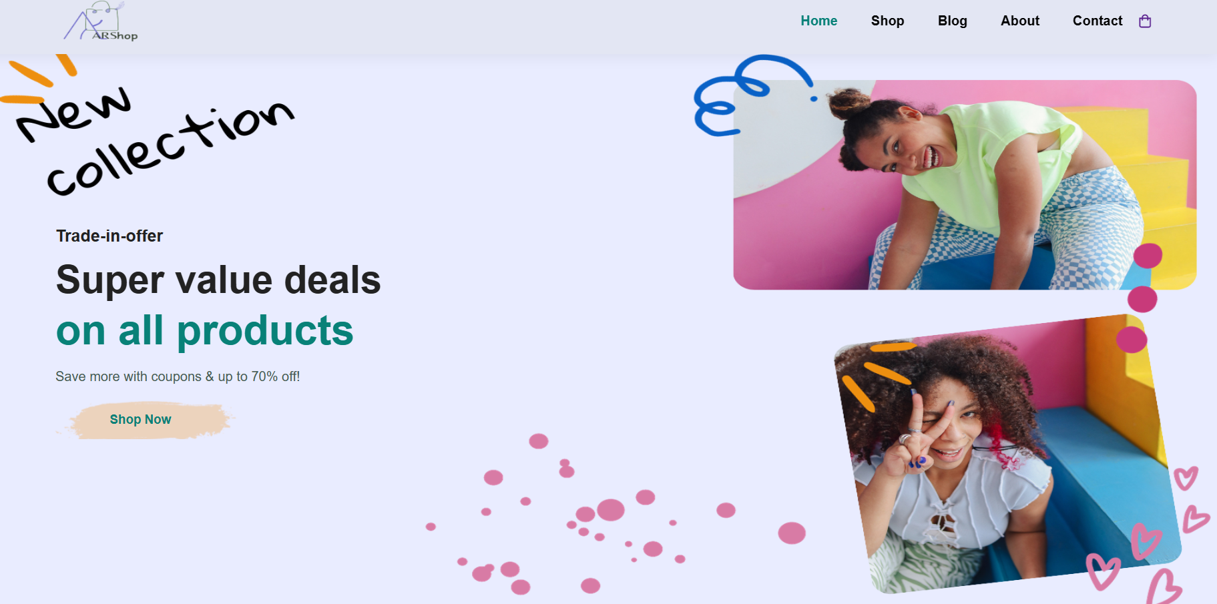
OUR SOLUTION
A powerful augmented reality shopping website where users can get first hand feel of visualising the virtual products in real world.

Slide 3
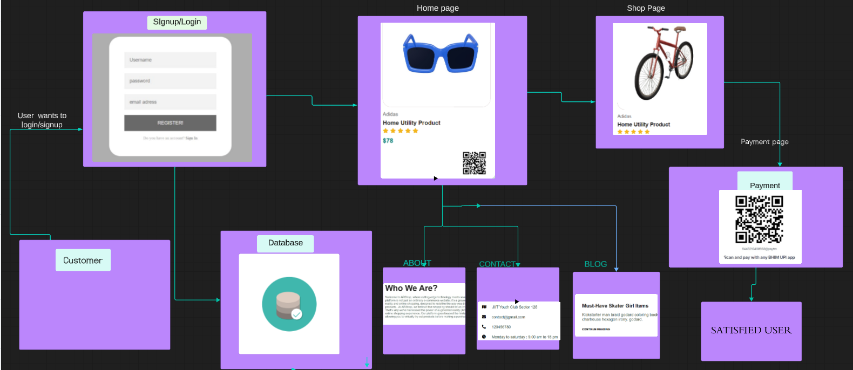
Architecture of the project

Slide 4
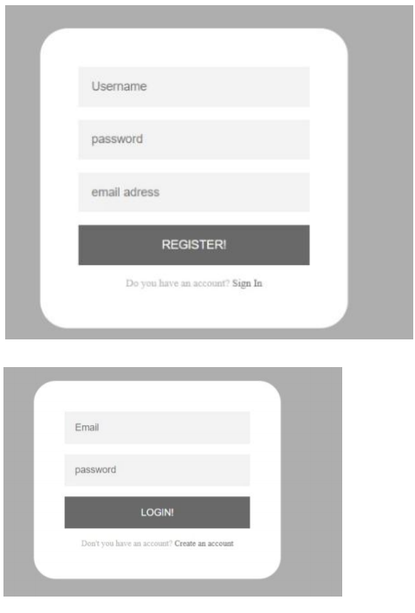
Authentication Page

Slide 5
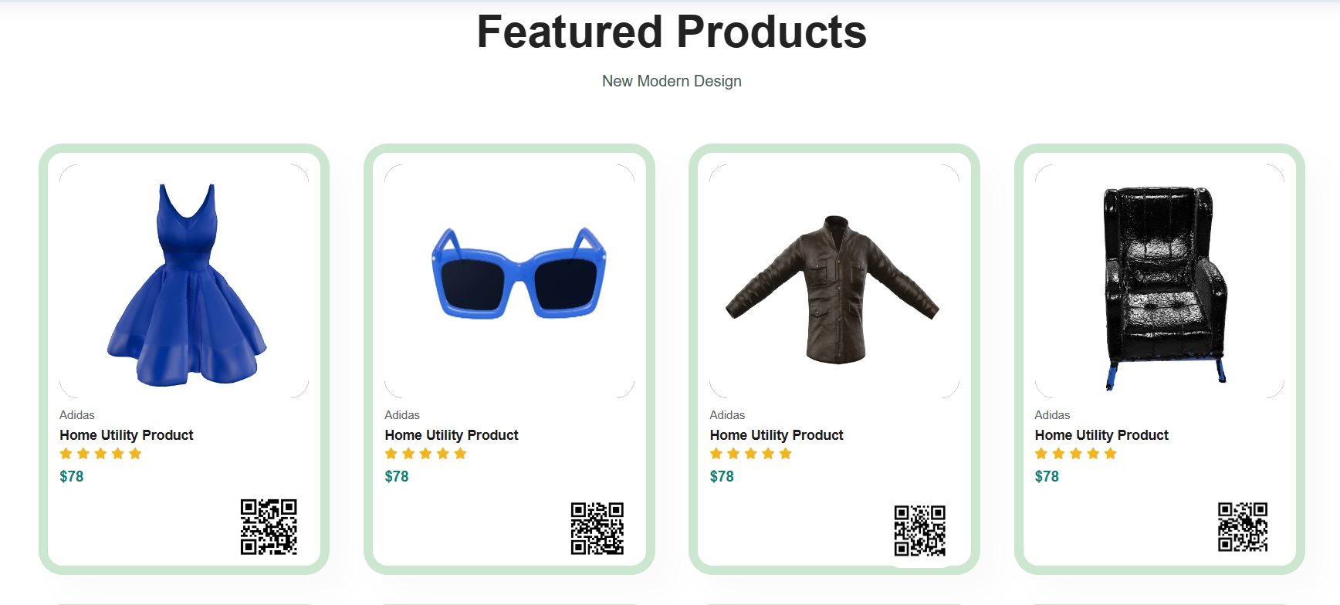
Here is the home page of our website:
Here we have different products listed with their prices. We also have a qr code next to them . These qr codes help to visualise the products in augmented reality upon scanning them.

Slide 6
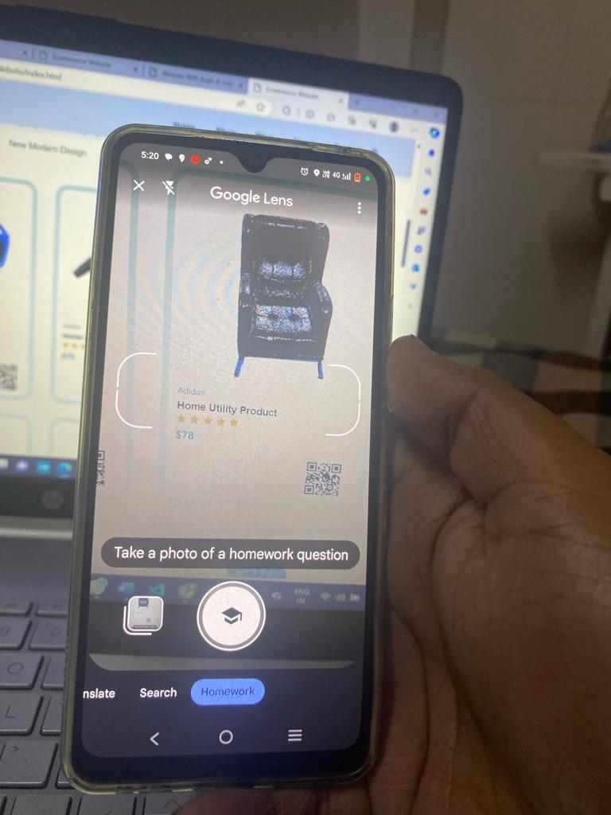
Here is the sample:
This is a product of our website . We try to scan its qr using google lens.

Slide 7
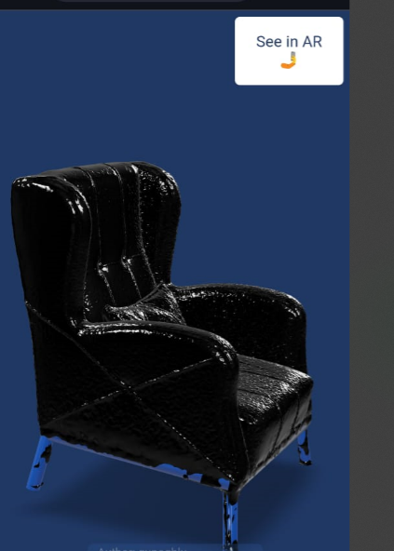
The user gets directed to AR experience page

Slide 8
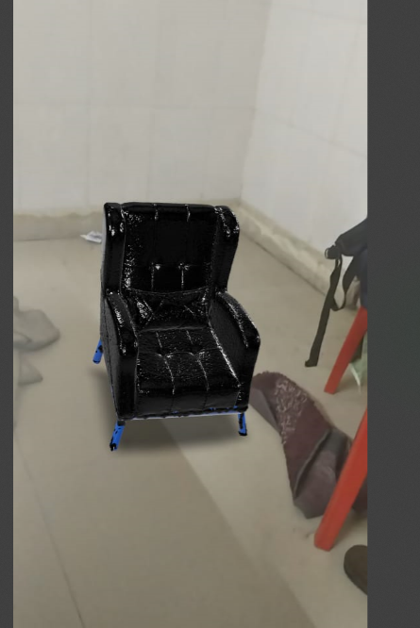
When product gets loaded the user can click view in AR button and see product in AR

Slide 9
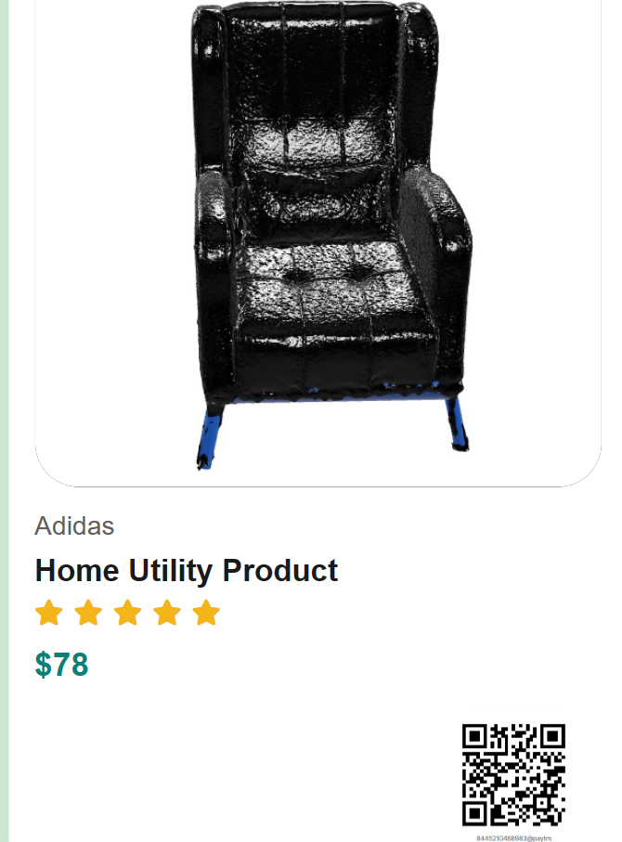
For payment, we have another set of dedicated QR codes in shop section

Slide 10
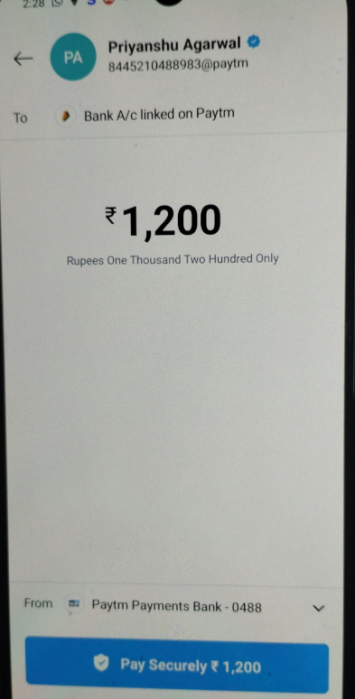
Upon scanning qr for payments, user will be directed to payments page like this.
The exact amount to be paid is encoded inside the qr. User just needs to scan and pay

Slide 11
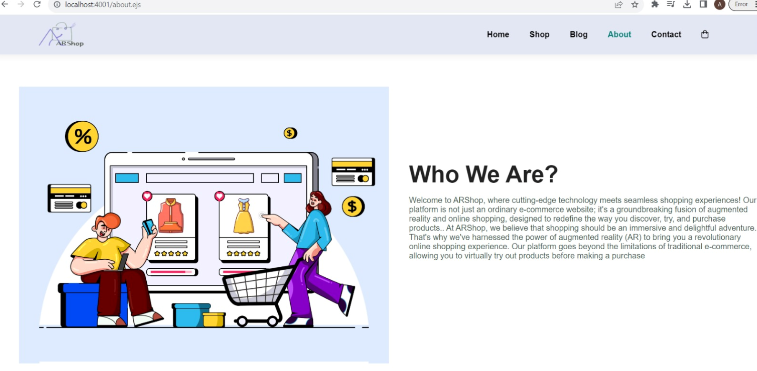
Some other eye catching sections of our website are:
About page:
Contains information about our AR project and its vision

Slide 12
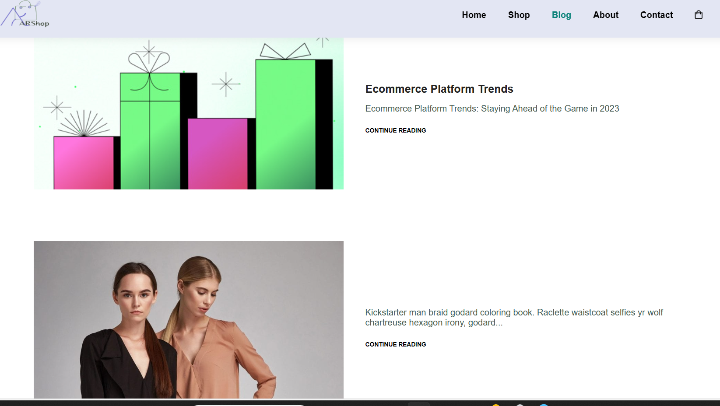
BLOG PAGE:
CONTAINS FASHION BLOGS

Slide 13
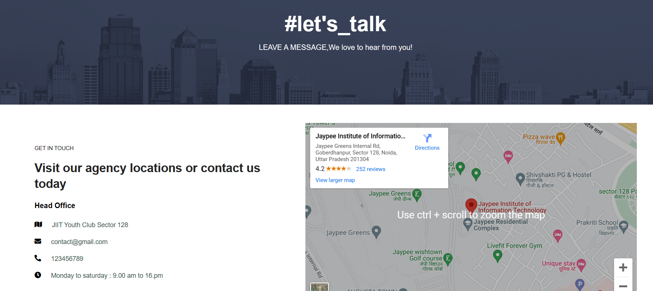
CONTACT PAGE:
Information about us and map to our location

Slide 14


